Slide 1
MORE SAFTY،
MORE HAPPINESS
INVESTING OPPORTUNITY

Slide 2
TABLE OF Contents
01
02
03
INTRODUCTION
TEAM
PROBLEM
04
05
06
SOLUTION
PRODUCT
ADVANTAGE

Slide 3
TABLE OF Contents
07
08
09
TRACTION
MARKET
COMPETITION
10
11
12
BUSINESS MODEL
INVESTMENT
CONTACT

Slide 4
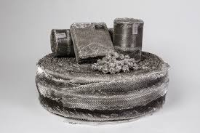
1-INTRODUCTION
Bard is a fine structured honey comb shaped network made from high quality metal alloy ,Bard lowers the upper explosion limit in a tank or container through heat abstraction so much that an explosion is prevented .
In addition Bard prevent evaporation of fuels that help environment and save the evaporated fuels.
.
Notes:
Hamidrezs Ahmadian

Slide 5
2-OUR TEAM
Hamidreza Ahmadian
MDA HARVARD University
CIVIL ENGINEERING UBC
M.AMIRI FIROUZ KOUHI
PHD STUDENT In Chemistry
More Than 40 Years ExperienceS

Slide 6
3-PROBLEM
Explosion
Annually, due to fuel evaporation, a large volume of valuable fuels are lost and while polluting the environment, it causes fuel cost. On the other hand, due to the high volume of fuel in tanks and Reservoirs, there is a possibility of fire and explosion of the tanks.
Explosion is defined as rapid burning of certain substances which causes high temperature and as a consequence high pressure which can lead to the bursting of the enclosing container.

Slide 7
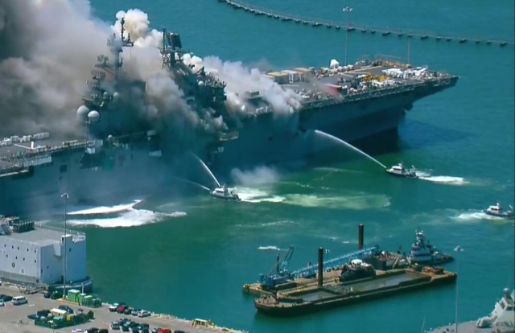
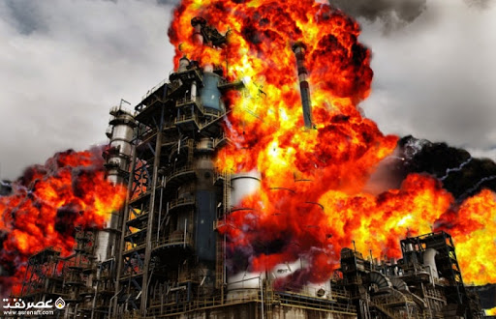
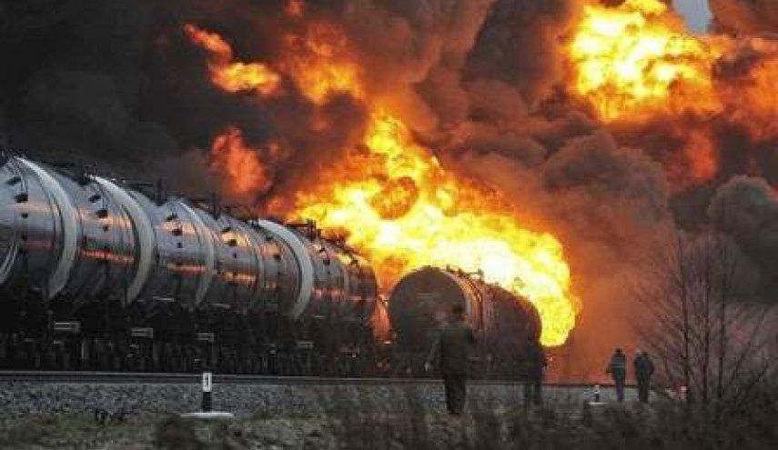
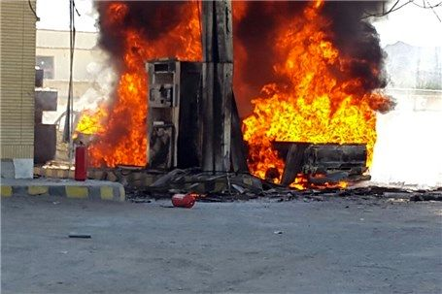
Examples of explosions
In all fuel tanks (liquid and gas) and alcohols (ethanol) there is a possibility of fire due to evaporation.
Explosion on the ship
Explosion at the refinery
Explosion on the train
Explosion at the fuel station

Slide 8
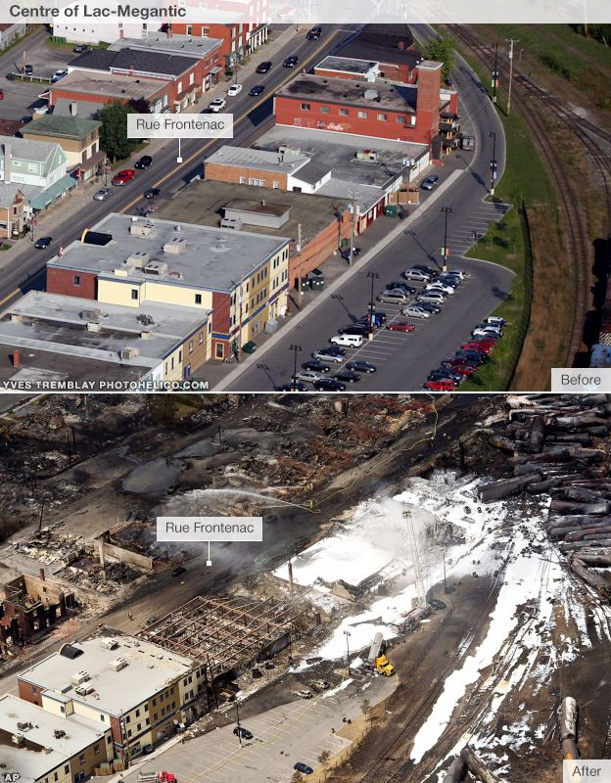
The Lac-Mégantic rail disaster
The Lac-Mégantic rail disaster occurred in the town of Lac-Mégantic, in the Eastern Townships region of Quebec, Canada, at approximately 01:15 on July 6, 2013, when an unattended 74-car freight train carrying Bakken Formation crude oil rolled down a 1.2% grade from Nantes and derailed downtown, resulting in the fire and explosion of multiple tank cars. Forty-two people were confirmed dead, with five more missing and presumed dead. More than 30 buildings in the town's center, roughly half of the downtown area, were destroyed, and all but three of the thirty-nine remaining downtown buildings had to be demolished due to petroleum contamination of the town site. Initial newspaper reports described a 1-kilometre (0.6 mi) blast radius.

Slide 9
4-SOLUTION
The Bard Explosion Prevention System relies on a precision engineered proprietary metal alloy mesh to provide extraordinary protection from evaporation and explosive combustion in fuel tanks and other vessels containing flammable liquids and gases .
The Bard special metal alloy has been developed to provide rapid thermal conductivity , rigid mesh structure , crush strength and superior corrosion resistance. This proprietary alloy is then custom machined in patented equipment to create an extraordinarily lightweight metal alloy mesh which , when installed in a fuel tank or other vessel containing flammable liquids or gases , will prevent evaporation and explosive combustion .

Slide 10
SOLUTION
liquids are evaporated in each temperature. The rate of evaporation depends on the quantity of liquid molecules in surface and reduce the vapor pressure.
Bard's network reduce the vapor pressure and the quantity of liquid molecules in surface .Therefore the rate of evaporation is decreased.
Boiling point will increase with Bard .
boiling point is defined as the degree which vapor pressure in liquid will be equal to vapor pressure on surface(atmosphere pressure) Bard's network reduce the vapor pressure in liquid these molecules has less energy and need more energy for evaporation therefore it boils in higher degree.

Slide 11
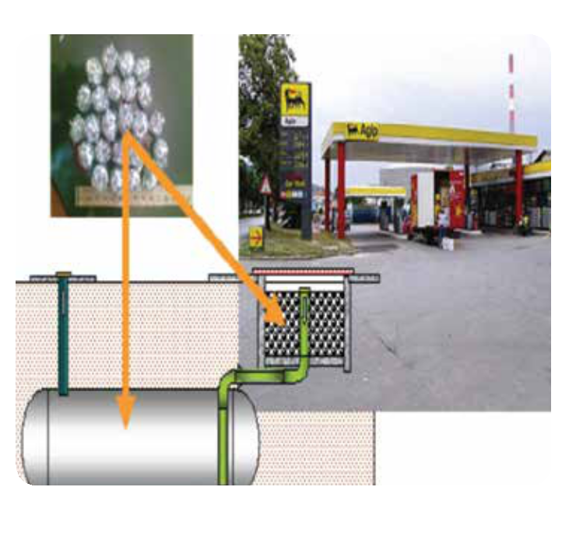
Explosion and Evaporation at the fuel station
By installing our products in distribution tanks with safety valves, fuel evaporation is significantly reduced.
The water hammer effect is prevented, caused by unexpected traffic conditions and thus avoiding possible road accidents.
The risk of explosion and losses due to evaporation during fuel loading and unloading is avoided, by preventing vapor generation during movements that take place along the route.
Protects against electrical charges

Slide 12
5-PRODUCT
BARD acts like a big flame arrester in the required application )e.g.tanks ) and the physical effects is to divide the temperature rapidly and quenching the flame. In case of ignition by sparks, open fire or firing upon, heat is deduced with sush high temperature and high pressure cannot to reached, therefore an explosion is eliminated. Bard foremost concern and aim is safety as the best possible protection for humans and the environment.

Slide 13
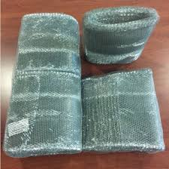
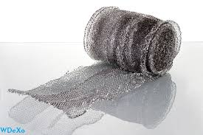
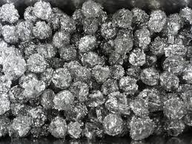
Types of Bard
Mats
Rolls
Balls
The bard network comes in different shapes: Mats & Rolls & Ball

Slide 14
Types of Bard
01
The standard roll form of the mesh is produced in widths of 55 mm, 75 mm and 125mm. In its mesh roll form, it is installed during fabrication and is assembled together with the other product components.
01
02
By processing the mesh rolls through a second set of manufacturing (ball) machines, mesh balls are produced in the standard size of 35mm diameter. The mesh balls are used for retrofit installation into existing items if the application object cannot be opened to be filled with standard mesh rolls.
Roll
Ball
02
Creative
03
when installed in tanks containing volatile fuels (hydrocarbons or oxygenates), prevents the explosion or detonation of the fuel (especially in gasoline tanks) and greatly reduces hydrodynamic ram effect from ballistic penetrations
Mats
03

Slide 15
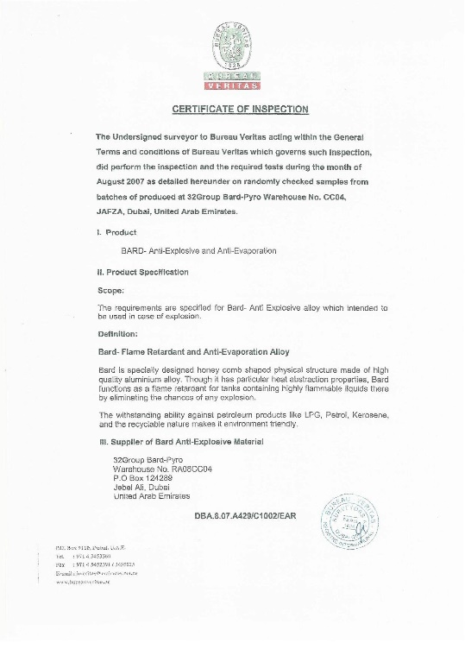
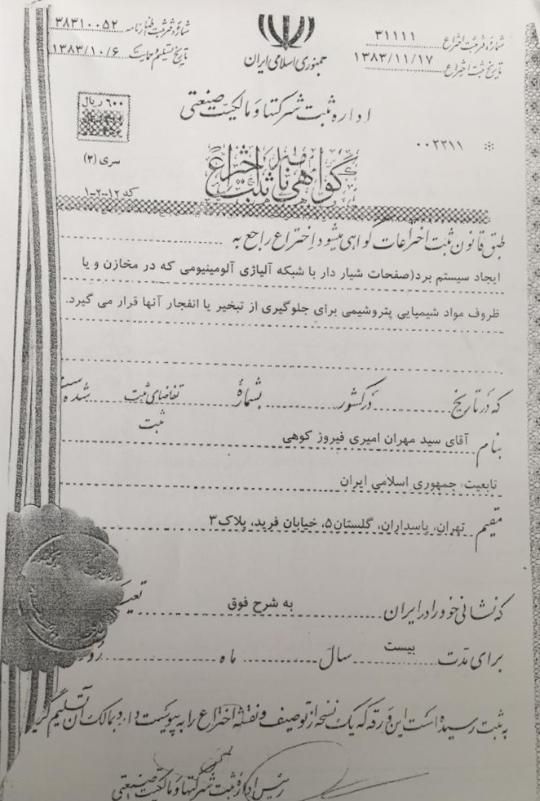
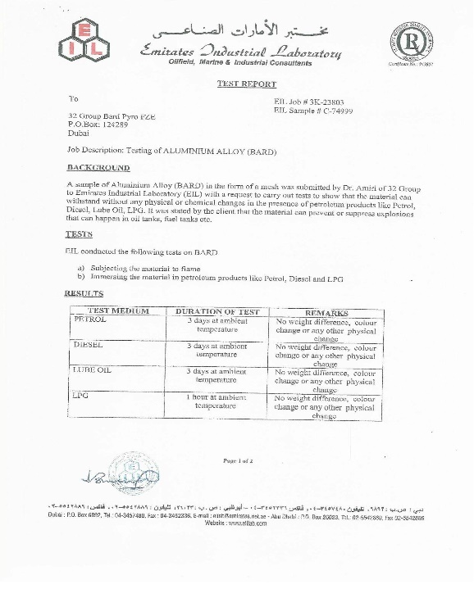
CERTIFICATS
United Arab Emirates Industrial Laboratory
Patent certificate from Iran
BUREAU VERITAS

Slide 16
6-Advantages
01
Reduces evaporation significantly (between 40 to 80%).
Options
02
Due to its high conductivity, it prevents the temperature from rising in a small area of ​​the tank.
Options
03
It has no chemical reaction with hydrocarbons, so it can be used for a long time.
Options

Slide 17
Advantages
04
It is easy to install in tanks under construction and tanks that have already been built.
Options
05
Prevents the removal of liquid inside the moving tanks.
Options
06
After installation in the tank, the maximum of 1.6% of the reservoir volume is occupied and its low density does not make a significant change in the tank weight.
.
Options

Slide 18
Advantages
07
100% can be recycled.
Options
08
If the fire prevents it from being flaming, That the fire will be easily manageable and controlled.
Options
09
Can be used in all flammable liquids and gases
Options

Slide 19
Advantages
10
Controls BLEVE ( boiling liquid expanding vapor explosion.
Options
11
Options
Allows welding of highly explosive tanks
12
Facilities the extinguishing of fire by controlled damming of its source
Options

Slide 20
Advantages
13
Electrostatic charge dissipation.
Options
14
Options
Slosh and surge reduction.
15
Stabilizes contents of tank replaces baffle plates
Options

Slide 21
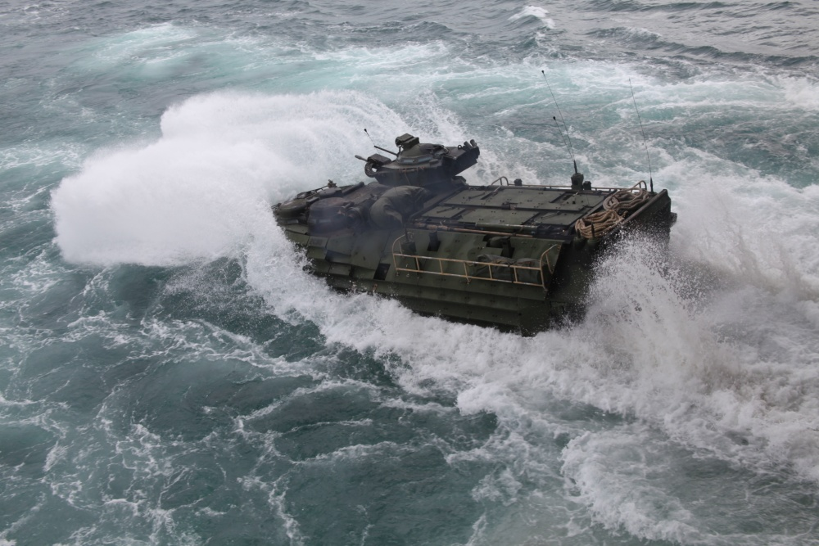
7-TRACTION
This product is recommended for the general public Examples include its uses
Military Vehicles (land & sea)
Police & VIP Vehicles

Slide 22
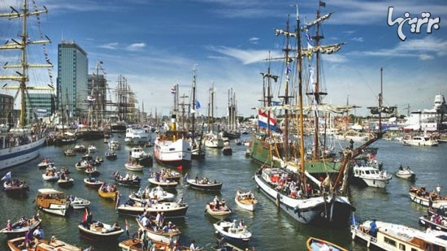
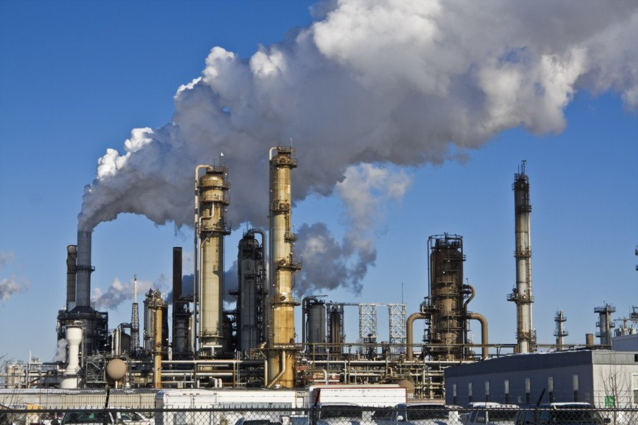
TRACTION
This product is recommended for the general public Examples include its uses
Boats & Yachts
Refineries

Slide 23
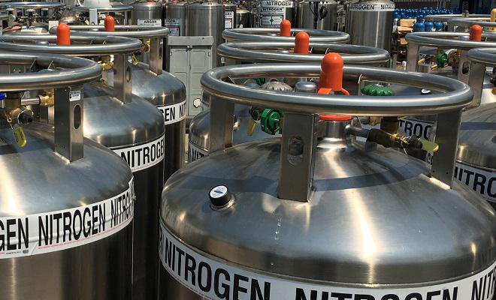
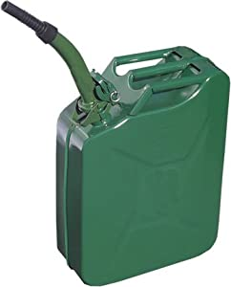
TRACTION
This product is recommended for the general public Examples include its uses
liquid gas bottles
fuel Containers

Slide 24
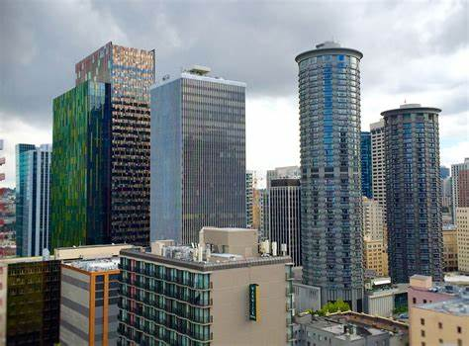
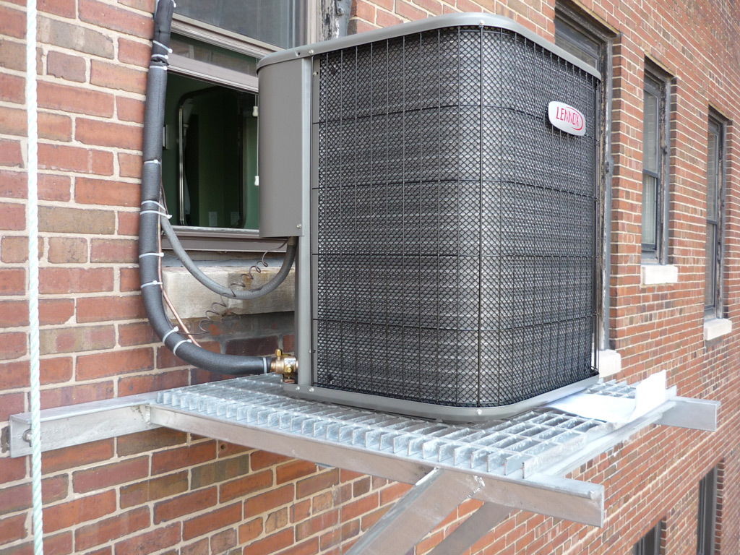
TRACTION
This product is recommended for the general public Examples include its uses
Buildings
Air Condition Systems

Slide 25
8-MARKET
Target Markets
Domestic Market
International Market

Slide 26
MARKET
75%
01
International Market
02
Domestic Market
25%

Slide 27
9-COMPETITION
Report Metric | Details
Years considered for providing market size | 2017–2025
Base year considered | 2020
Forecast period | 2020–2025
Forecast units | Value (USD) in million/billion
Segments covered | Product, service, and vertical
Regions covered | North America, APAC, Europe, and RoW
Companies covered | Johnson Controls (Ireland), United Technologies (US), Honeywell (US), Siemens (Germany), Halima (UK), Robert Bosch (Germany), Hochiki (Japan), Gentex (US), Minimax Viking (Germany), Securiton (Switzerland), Encore Fire Protection (US), Fire Suppression (UK), Schrack Seconet (Austria), Napco Security Technologies (US), VFP Fire Systems (US), S&S Fire Suppression Systems (US), Fireline (US), ORR Protection (US), Argus Fire Protection Company (UK), Firetrol Protection Systems (US).

Slide 28
Attractive Opportunities in Explosion proof Equipment Market
The Global Explosion Proof Expected To Grow From USD 7.4 Billion In 2020 To USD 9.9 Billion By 2025, At a Cagr Of 5.9% During The Forecast Period.
The increasing industrial safety measures is one of the drivers for the growth of the explosion proof equipment market in the coming years.
Due to the presence of large number of oil and gees ( off-shore and on shore) industries in the region, row is one of the fastest growing regions for the explosion proof equipment market.
USD
9/9
Billion

Slide 29
Explosion Proof Equipment Market
9.9
7.4

Slide 30
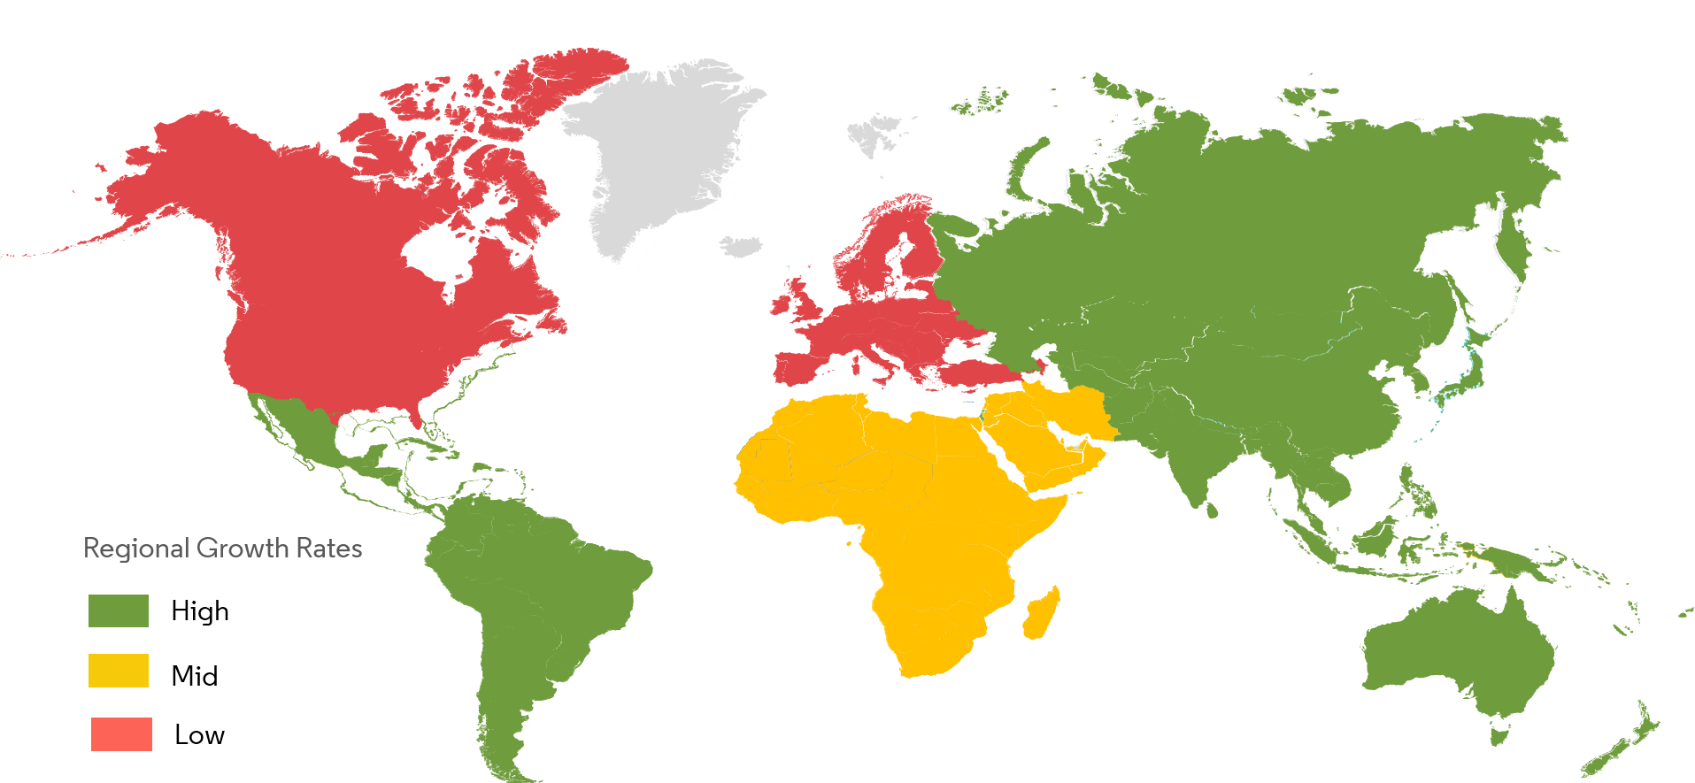
Explosion Proof Equipment market- Growth Rate By Region (2019-2024)

Slide 31
10-Business Model
Key partners | Key Activities | Value Propositions |  | Relationships | Customer segments
 | Key Resources |  |  | Channels
Cost structure |  |  | Revenue Streams
Build Infrastructure
Customer service
Marketing
Product development
International management
Easy Of Use
Support team
Consulting services
The common People
Distribution partners
investors
Light Weight
Everywhere
Brand
Website
Access To Millions Of Customers
manpower
Don’t Need To Sharge
Website
Staff
Infrastructure
Product Sales
Logistics
Development

Slide 32
11-INVESTMENT
OUR TEAM
INVESTORS & BANK
LAND
SHOP & BUILDING
UTILITIES
CASH FLOW
KNOW HOW MACHINERY MANAGEMENT

Slide 33
12-CONTACT
THANK YOU!
CONTACT US AT:
Mr .Mehran Amiri
usa.mehran@yahoo.com
+1 778 881 8193

