Slide 1
The Novel Approach
in Fire Control Technology
PYRO
PhD Defense M. Amiri Firouzkouhi
usa.mehran@yahoo.com

Slide 2
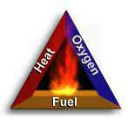
Chemistry of fire
For fire to exist, the following four elements must be present:
Enough oxygen to sustain combustion
Enough heat to raise the material to its ignition temperature
Some sort of fuel or combustible material, and
The chemical reaction that is fire.
Take away any of these and the fire will be extinguished

Slide 3
Classes of fire
Fires are classified according to the type of fuel that is burning.
Using the wrong type of fire extinguisher on a fire may make matters worse.
The five different fire (fuel) classes…
Solids – class A fire – paper, wood, textiles etc
Liquids or liquefiable solids – class B fire - petrol, diesel, hydrocarbons
Electrical – class C fire
Metals – class D fire – Magnesium, Titanium
Cooking oil fires – class F – deep fat fryers, commercial kitchens etc

Slide 4
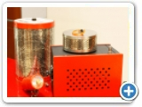
What is Pyro?
Renovation of Pyrotechnolgy
PYRO
Pyrotechnically formulated aerosol fire extinguisher used to suppress and
extinguish fire.

Slide 5

Renovation of Pyrotechnolgy:
The secret of PYRO’s Power
Unique formulation
- solid aerosol generating composition
- solid chemical coolant
ensures flameless operation and rapid expulsion
Thermal
- Automatic through temperature sensitive pyrotechnic cord 175℃
Combustible label cover
Directional plate
Coolant grid
Chemical coolant
Separator grid
Thermal ignition device
Spacer ring
Electrical ignition devices
Solid aerosol generating
composiiton
Heavy duty alminum
alloy casting
Igniter circuit connector

Slide 6
Multiple Activation for Activation
Technical Characteristics:
By Electrical Activation
  Automatic via detection system or,
  Manual via electrical manual release point
By Thermal Activation
  Automatic via pyrotechnic fuse – Fire Cord
  Self operation at 500oC
By Manual Activation
  Manual via ‘grenade’ type pin

Slide 7
Aerosol Generation
Technical Characteristics:
Ignition of aerosol-forming composition = solid potassium carbonates + carbon dioxide gas + nitrogen gas + water vapor
KNO_{3(s)} + C_{n}H_{m}N_{p}O_{q(s)} + C_{(s)} =
KHCO_{3(s)} + K₂CO_{3(s)} + CO_{2(g)} + N_{2(g)} + H₂O_{(g)}

Slide 8
3 Potential Methods of Actuation
How It Works:
Generator Heated to 500ºC
Electrical Signal
from Control Panel
(Manual / Automatic)
Naked Flame or Heated >175°C
Via Fire Conducting Cord

Slide 9
How it works:
3 potential methods of Actuation
Container heated more than 500 ℃
Chemical coolant decomposes
Absorbing heat
Total spreading aerosol
demonstrates 3D gas-like
properties for 50 minutes
Electrical signal from
Control Center
Decomposed chemical coolant
Direct flame or heat
Over 175℃ through
Fire conducting cord

Slide 10
How it works:
Aerosol Generated
Chemical coolant decomposes absorbing heat
Fire fighting aerosol rapidly generated

Slide 11
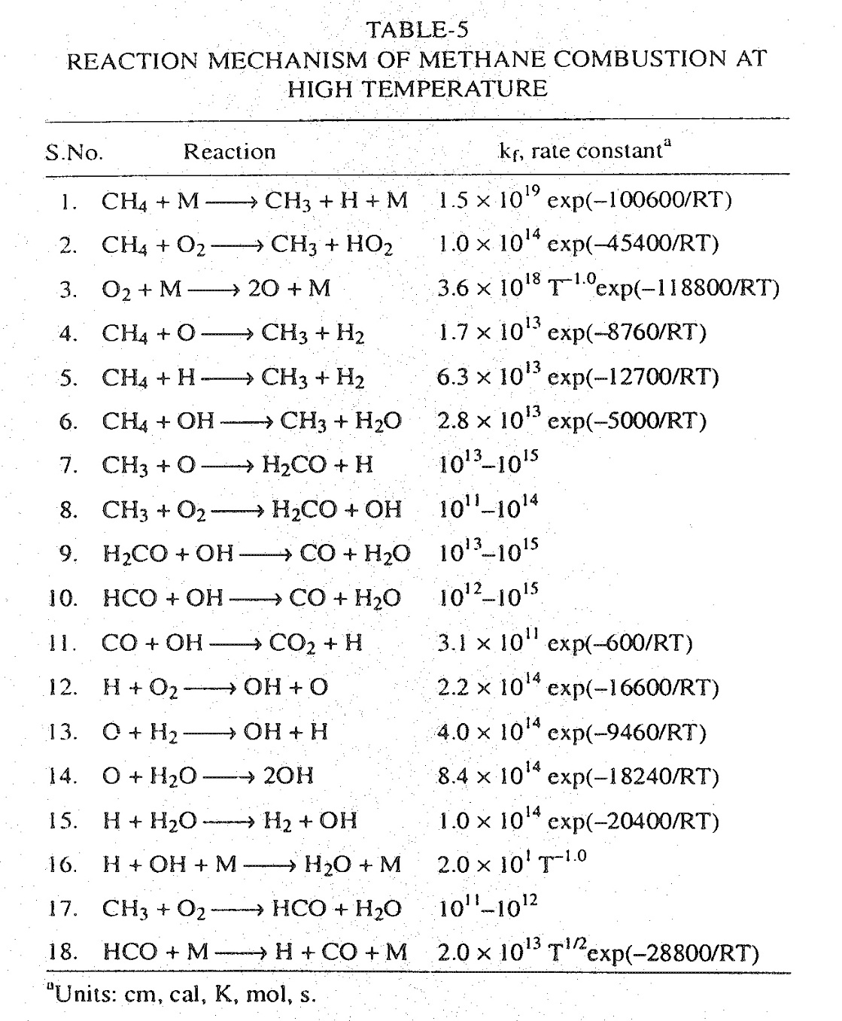

Slide 12
Basics
The three Elements of Fire
Oxygen
O₂
O₂
O₂
Chain Carriers
O, H & OH
Heat
Fuel

Slide 13
Basics:
The Fourth Element of Fire
Oxygen
O₂
O₂
O₂
Chain
Carriers
O,H and OH
Heat
O
O
OH
H
OH
Fuel

Slide 14
How it works:
Dual Extinguishing Actions
Chemical Removal of chain carriers OH, H and O
in gaseous phase:
K+ OH = KOH
K + O = KO
KOH + H = K + H₂O
on particles surface:
O + H = OH
H + OH = H₂O
Physical Heat absorption
KHCO₃ =K₂CO3 + CO₂ +H₂O
K₂CO₃(S) = K₂CO₃(g)

Slide 15
How it works:
Extinguishing Actions
Two Chemical Mechanisms
Removal of flame propagation radicals - chain
Carriers OH, H and O in the flame chain
on particles surface:
K + OH = KOH
KOH + H = K + H₂O
Recombination of flame OH, H and aerosol on particles
surface:
O + H = OH
H + OH = H₂O

Slide 16
Aerosol Discharged
How It Works:
Total flooding aerosol demonstrates 3D gas-like properties.
Holding times up to 60 minutes.
Decomposed chemical coolant

Slide 17
The Three Elements of Fire
Basics:
O₂
O₂
O₂
Heat
Fuel

Slide 18
Extinguishing Actions
How It Works:
O₂
O₂
O₂
Oxygen
Chain Carriers
O, H & OH
Chain Carriers
O, H & OH
O
H
OH
Heat
Fuel
Heat
Fuel

Slide 19
Extinguishing Actions
How It Works:
O₂
O₂
O₂
PYRO
K
K
O
H
OH
K
Heat
Fuel

Slide 20
Extinguishing Actions
How It Works:
O₂
O₂
O₂
K
Oxygen
O
K
Flame Chain Broken
O
H
K
Fuel
H
Fuel

Slide 21
Extinguishing Actions
How It Works:
O₂
O₂
O₂
Oxygen
Chain Carriers
O, H & OH Remove from the Flame Chain
Flame Chain Broken
Fuel
Fuel

Slide 22
Advantages
Technical Benefits:
Zero ozone depletion potential
Zero global warming potential
No synthetic chemicals
No stored gases or liquids - No leakage
Non-corrosive
Non-conductive
Minimal residue
No low temperature thermal shock
Simple to design install & maintain
Cost effective

Slide 23



No Effect On The Environment!
Benefits:
No effect on the ozone layer as Pyro in its molecular structure – zero GWP & zero ODP. PYRO
does not contain Chlorine, Fluorine, or
bromide in its components

Slide 24
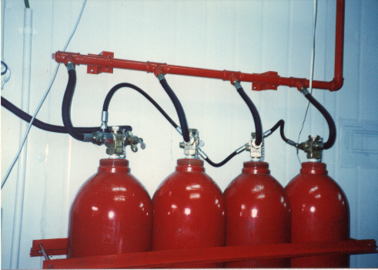
No Pressurised Cylinders or Pipe Work
x
Benefits:
Self Contained
Zero Pressure
Light & Safe to Handle & Transport

Slide 25
Benefits:
Compact and Weight Saving
Guaranteed to save you space !
Pyro
Halon 1301
FM-200
FE-13
CO₂
Inert Gas

Slide 26

Significant Cost Savings
Benefits:
No Piping or Pressure Cylinders Required
Minimal Maintenance
  No leakage
  No recharge
Simple Design & Installation
Long Shelf Life: 50 years
No staining on furniture

Slide 27
Benefits:
Primary Method of Fire Extinguishment
Chemical
Physical
Pyro
Halon 1301
FM 200
CO₂
Inergen
Fire Sprinkler

Slide 28
Application
Machine rooms, cellars, chemical shops, painting chambers, cable tunnels, hotel rooms, apartment high rise buildings
Reservoirs, storage vessels for oil products and liquid gases, pump room handling combustible substances
Means of transportation
Motor vehicles, ship, train, air plane and
naval vessels, military vehicles

Slide 29
Models Available
Pyro:
Parameter
M-02
M-1
M-2
M-3*
M-4
M-5*
Mass of Generator g
110
400
500
700
4,500
1,830
Mass of Aerosol
Forming Composition g
20
60
100
200
1,000
500
Max Protected Volume m³
@ 100 g/m³
0.2
0.6
1
2
10
5
Nozzle Outlet
bi
mono
mono
mono
bi
mono
Length mm
120
80
95
145
350
190
Diameter mm
25
75
75
75
95
95
Discharge Time sec
< 2
< 3
< 5
< 7
< 10
< 8
* M 3 and M 5 aravailable in “grenade” format for manual fire fighting

Slide 30
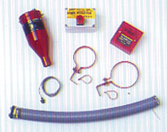
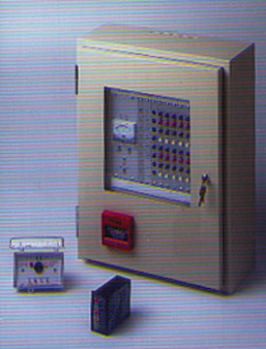
Designed to Complete Pyro’s
System Supply for Specific Installations
Optional Accessories
Accessories include:
  Fire Panels
  System Isolate Switches
  Directional Nozzles
  Manual Release Points
  Pyrotechnic Fuses
  Support Brackets
  Warning Signage

Slide 31
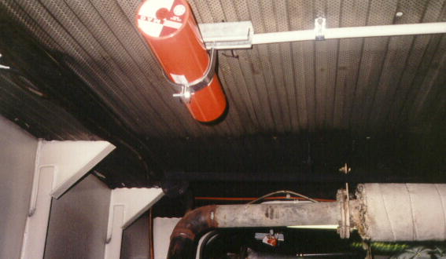
Generator Room Protected By Pyro
Typical Installation

Slide 32
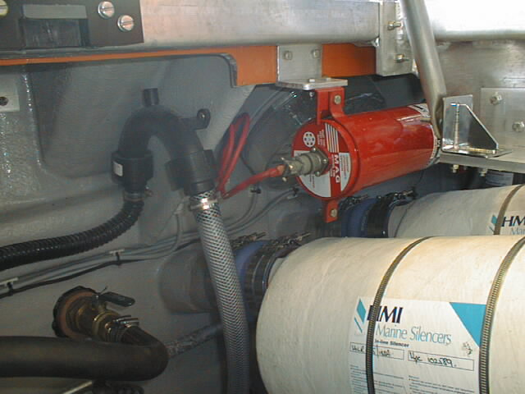
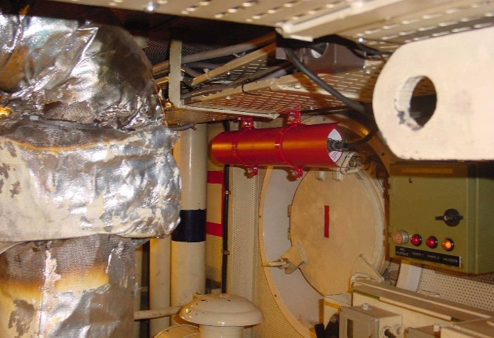
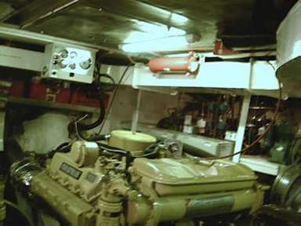
Pyrogen Marine Systems
Typical Installation

Slide 33
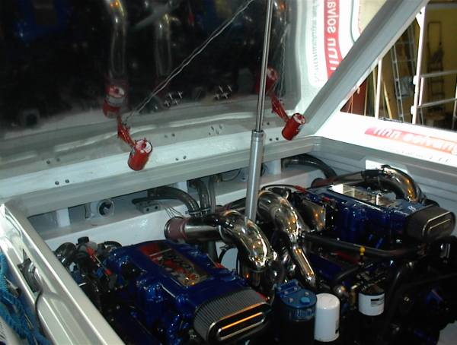
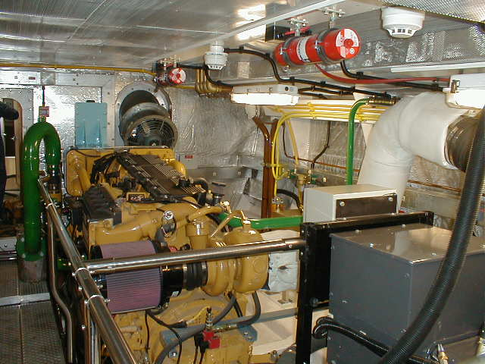
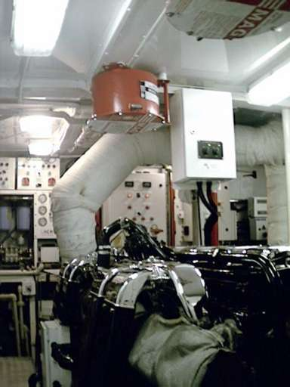
Pyrogen Marine Systems - 2
Typical Installation

Slide 34
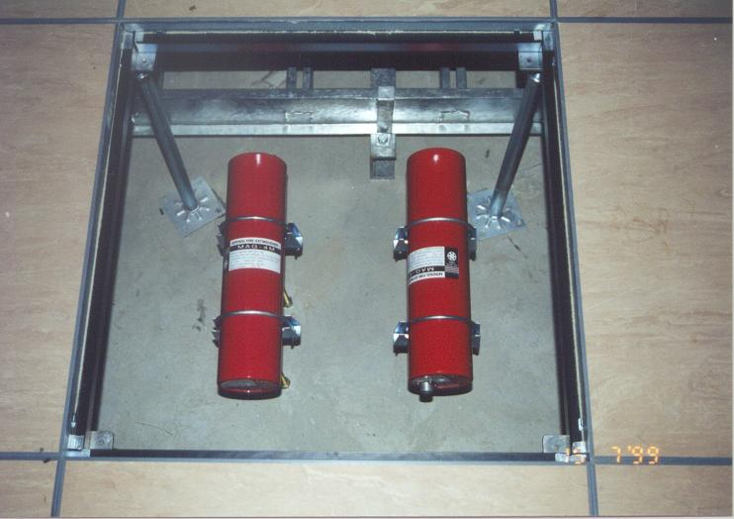
Raised Floor Protected By Pyro
Typical Installation

Slide 35
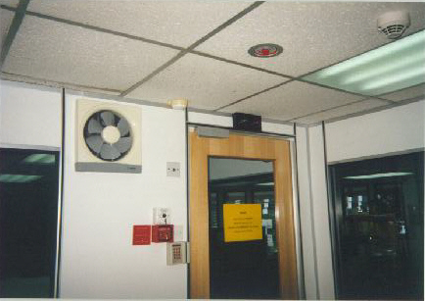
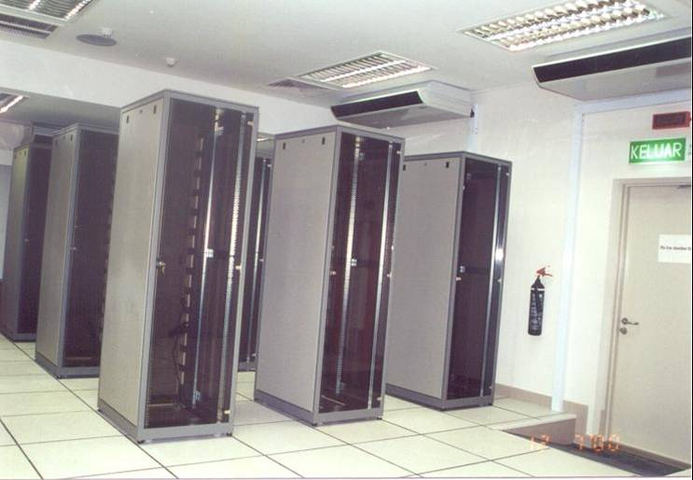
Computer Rooms Protected by Pyro
Typical Installation

Slide 36
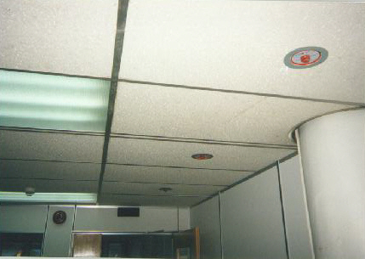
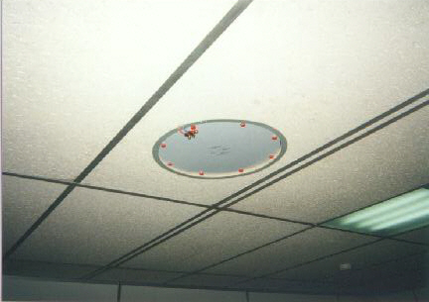
Ceiling Concealed (Single)
Typical Installation

Slide 37
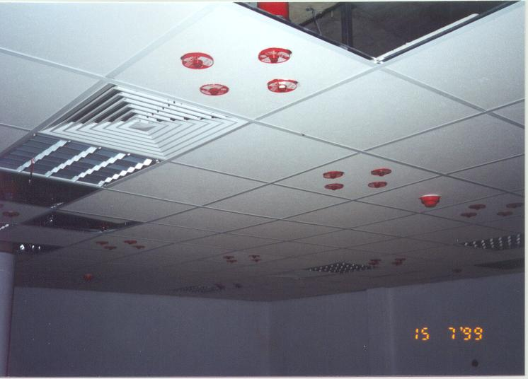
Ceiling Concealed (Multiple)
Typical Installation

Slide 38
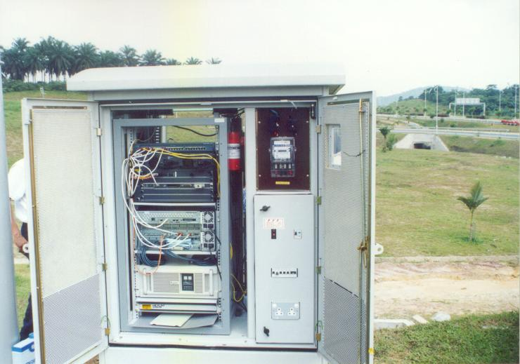
Pyro Mounted inside Remote Traffic Control Radio Station
Typical Installation

Slide 39
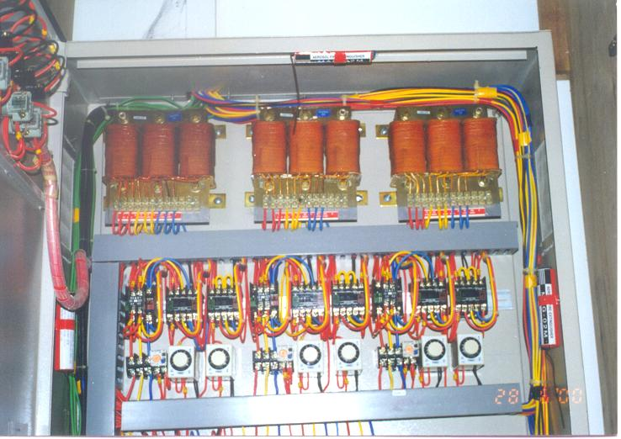
Pyro Installed in Switchgear
Typical Installation

Slide 40
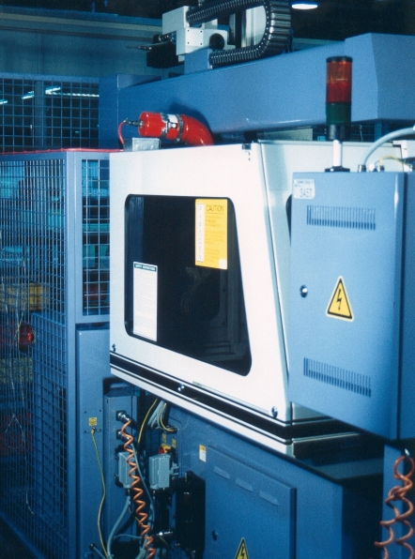
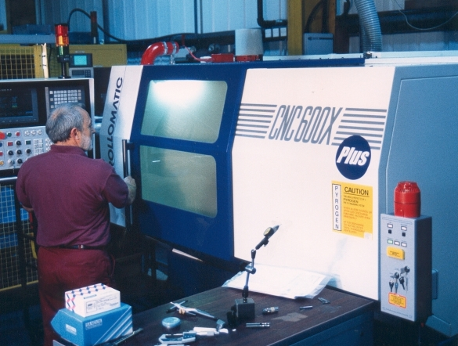
Pyrogen Protecting CNC Machines
Typical Installation

Slide 41
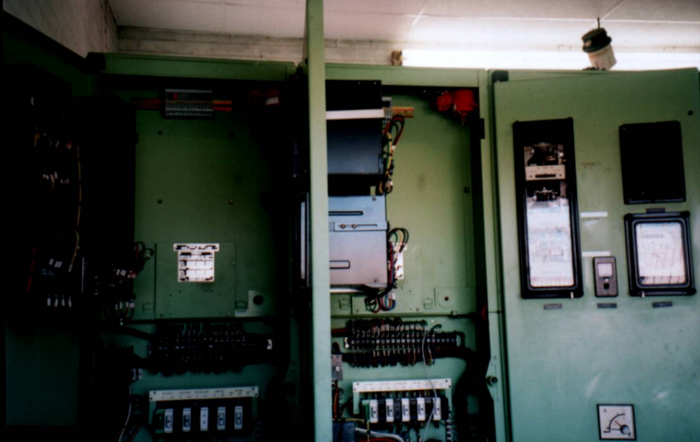
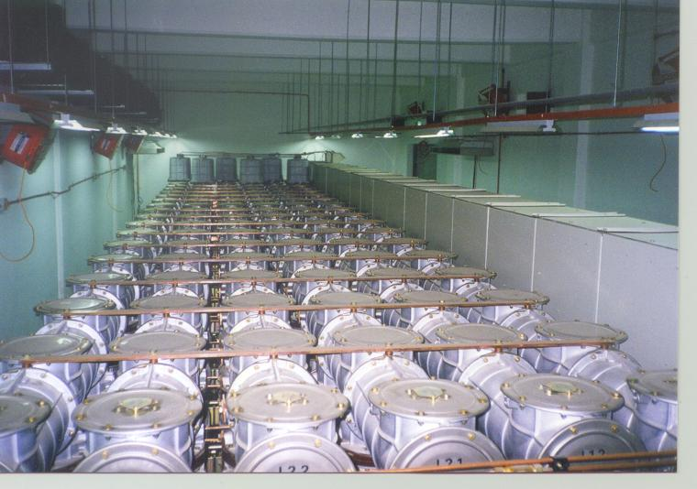
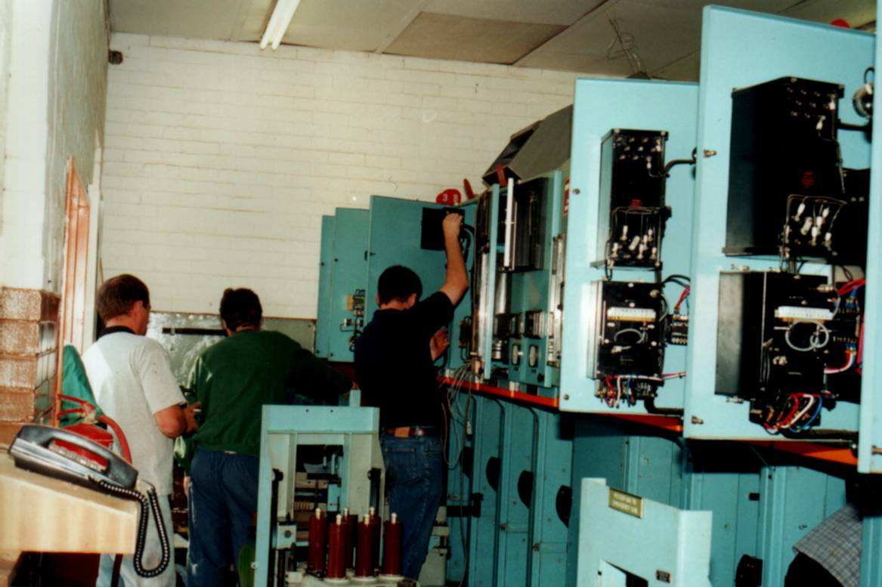
Pyro Total Flood Switchgear Protection
Typical Installation

Slide 42
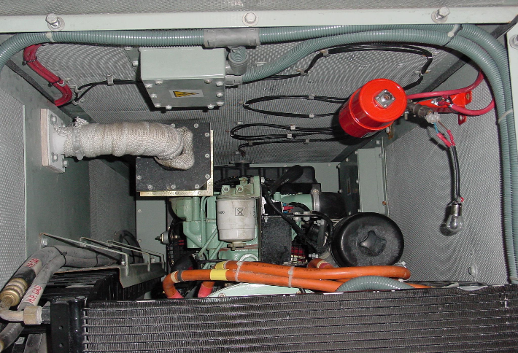
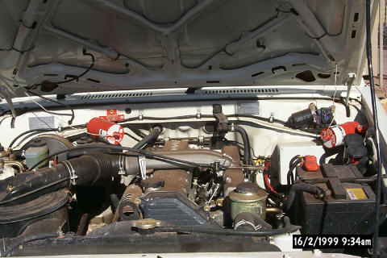
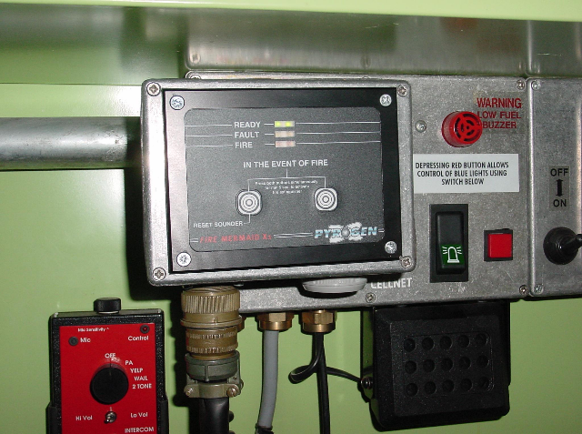
Pyrogen Vehicle Systems
Typical Installation

Slide 43
Conclusion:
Automatic (no human intervention)
Available in “grenade” format for manual fire fighting
Three times effective than Halon 1301
No hazardous to the Environment
Oxygen content is not dropped below 20%
No air pomp for pressurized cylinders
Space saving
Maintenance-Free
Simple installation
Cost saving
PYRO

